Slide 1
FB Material feeding poka-yoke
(Backend Programming)
Olarinde Joseph Korede
ShzP/COR

Slide 2
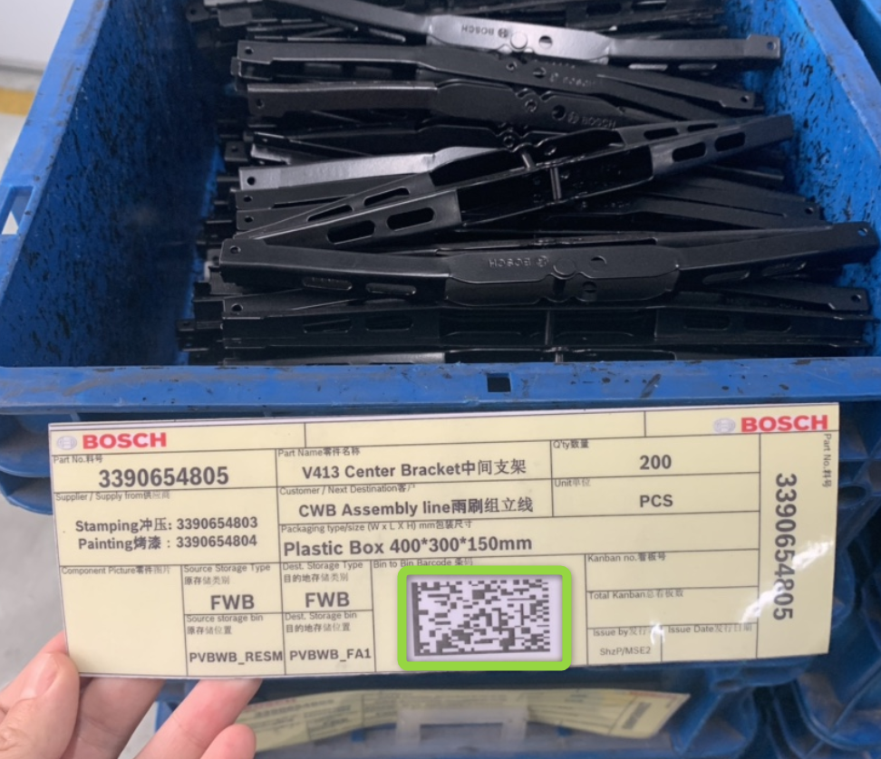


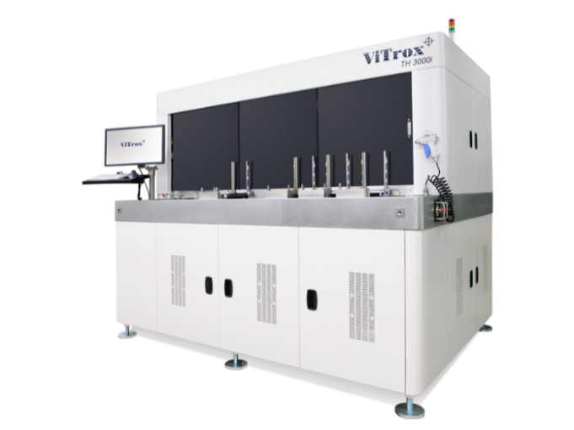
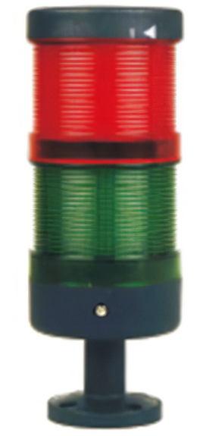
Concept: Technical description
FB Material feeding poka-yoke (Backend Programming)
◆ Concept overview: Software Requirements
Upload 13 digits PN in poka-yoke system before C/O
Scan component QR code to identify if it’s correct material
PN 1: 3398.000.001
Red light: NG, MAE stop running
Poka-yoke system feedback
Green light: OK, MAE runs

Slide 3
Concept: Technical requirement
FB Material feeding poka-yoke (Backend Programming)
◆ Concept overview: Software Requirements

Slide 4
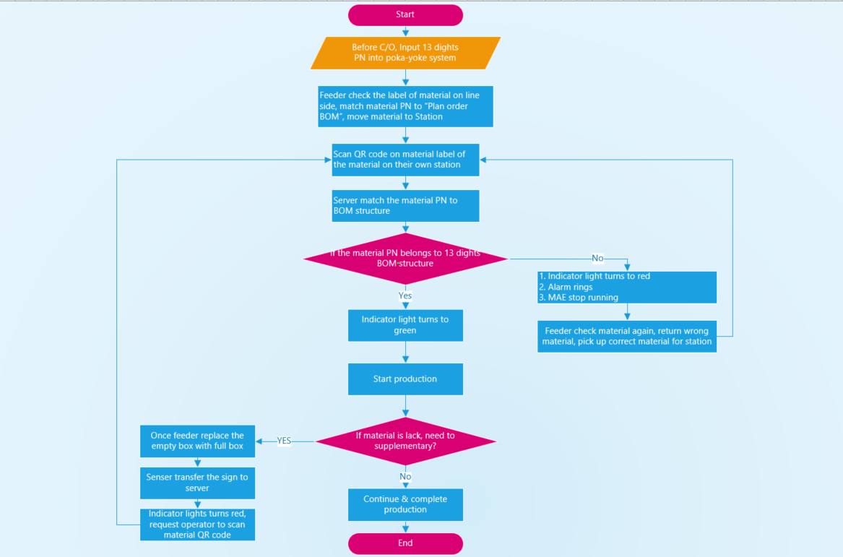
Concept : Software Flow
FB Material feeding poka-yoke (Backend Programming)
◆ Concept overview: Process flow

Slide 5





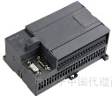

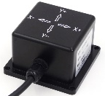
Concept: Architecture Layer
FB Material feeding poka-yoke (Backend Programming)
◆ Concept Overview : Software/Hardware
Level 1
Server
FB
Core switch
CWB
Level 2
PC
Access switch
PC
Cabinet/line
Cabinet/line
Multi-serial-port Card
IO controller
Multi-serial-port Card
IO controller
Level 3
Station
MAE PLC
MAE PLC
Station
Scanner
Light
Sensor
Light
Sensor
Scanner
Notes:
线体PC
线体PC硬件上，通过串口连接扫码枪。通过io控制器连接塔灯和传感器。否则现场这些终端没有可以接入的设备。
线体PC软件上，控制线体防错逻辑的运行。如果这部分逻辑放到服务器来运行，需要提升服务器的性能。
线体PC的显示屏，可以起到人机界面的作用。当发生异常状况时，可以通过这个界面来排查。
通过PC人工可以进行换型操作，以及对应零部件显示，可实时查询历史记录。
服务器：
服务器起到数据存储和总控的作用。
系统目视化界面
pc界面：
1.pc 界面具备数据扫描识别显示界面，显示扫描到的数据信息和匹配结果，补料信息记录。
2.Pc界面具备数据补录功能
3.Pc界面具备数据查询功能
4.Pc界面具备数据录入功能
5.Pc界面具备数据维护功能
6.Pc界面具备信息报警功能
7.故障显示与确认功能

Slide 6
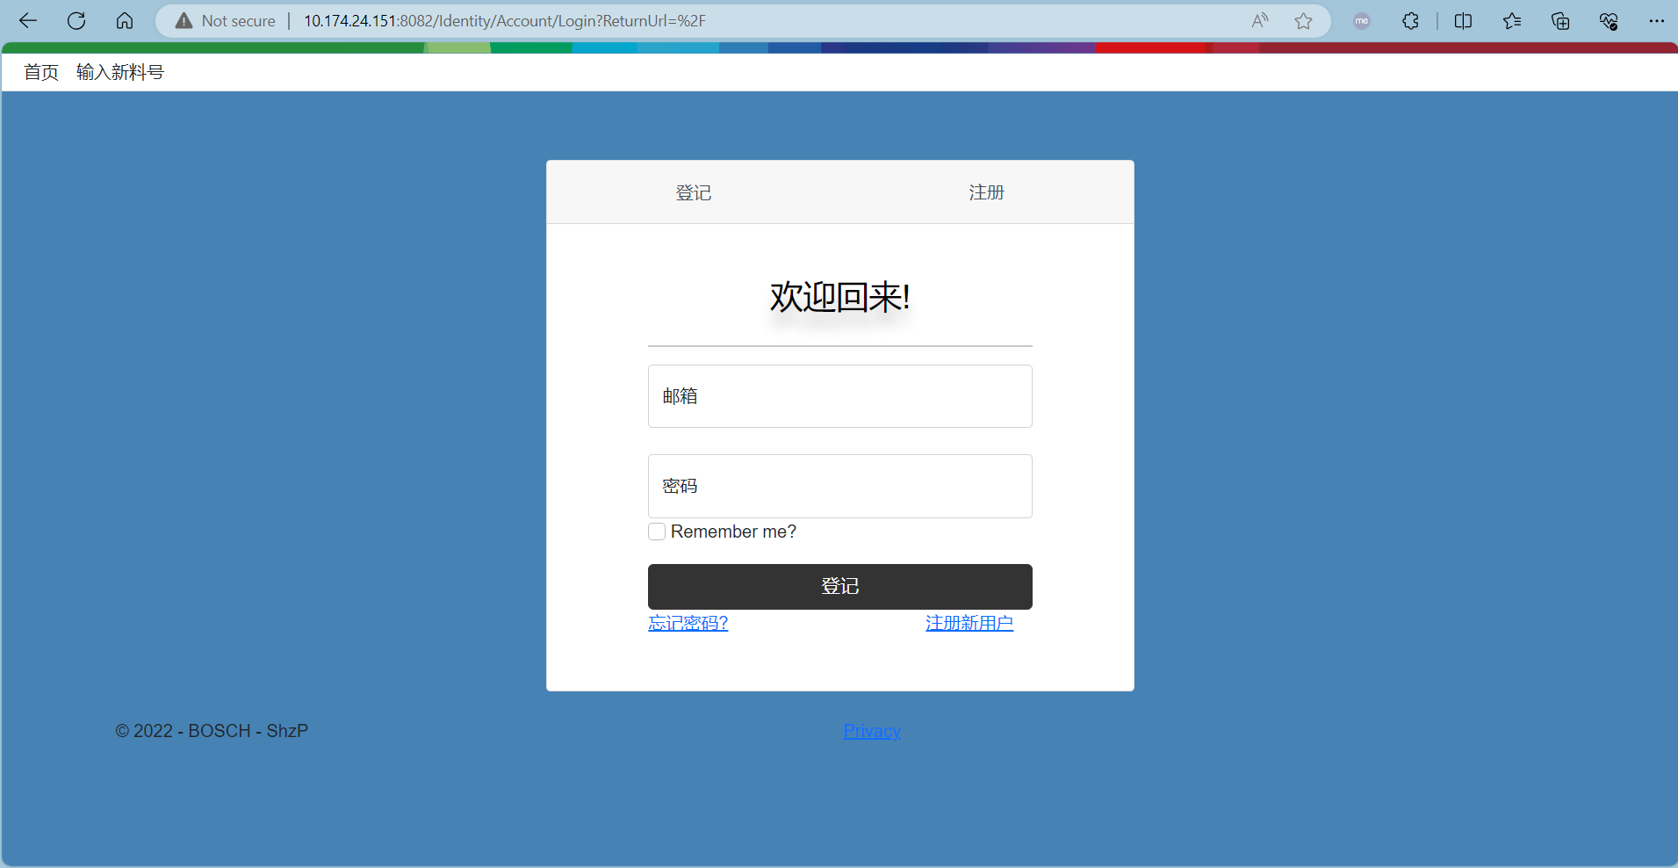
Demo
FB Material feeding poka-yoke (Backend Programming)

Slide 7
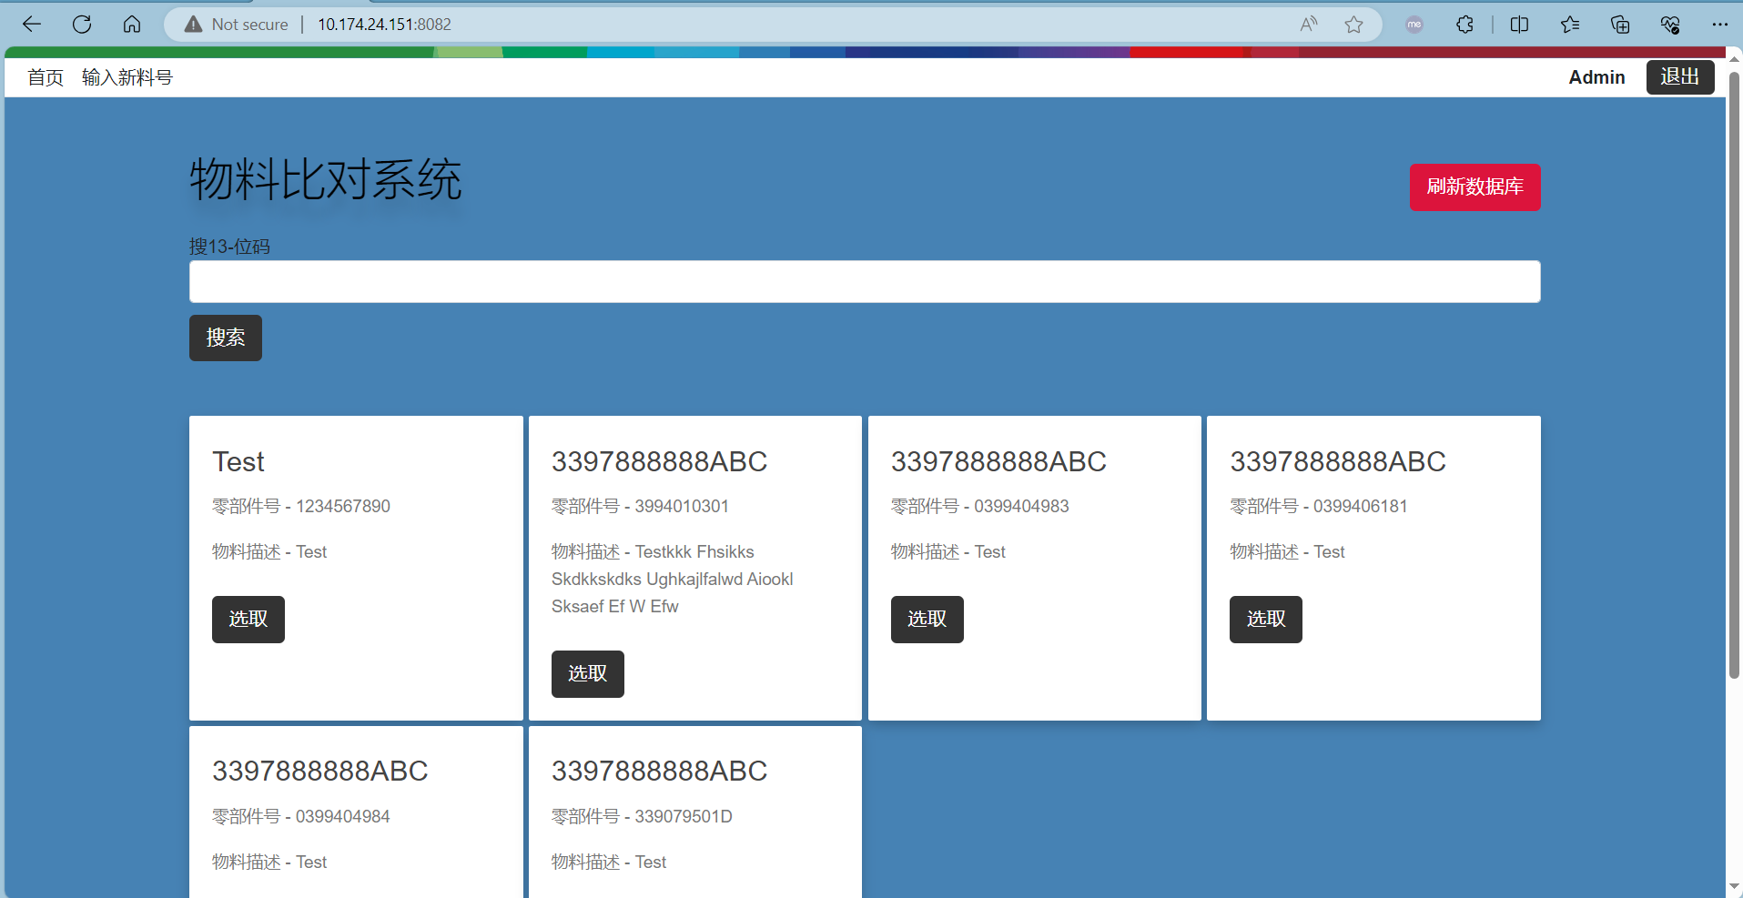
Demo
FB Material feeding poka-yoke (Backend Programming)

Slide 8
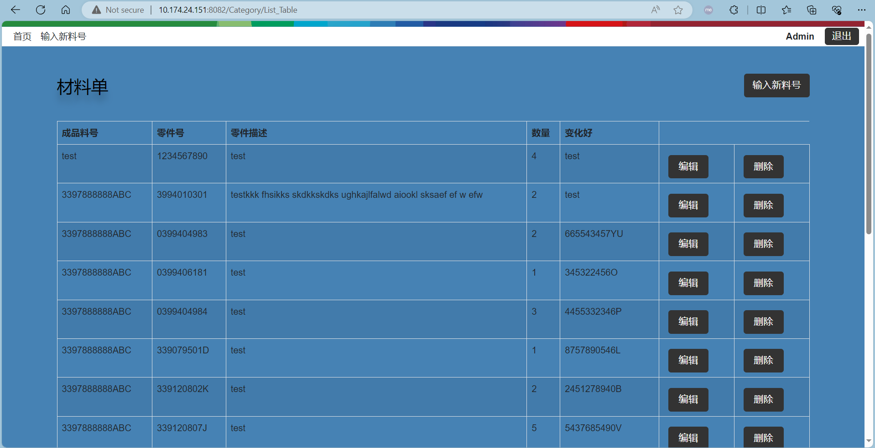
Demo
FB Material feeding poka-yoke (Backend Programming)

Slide 9
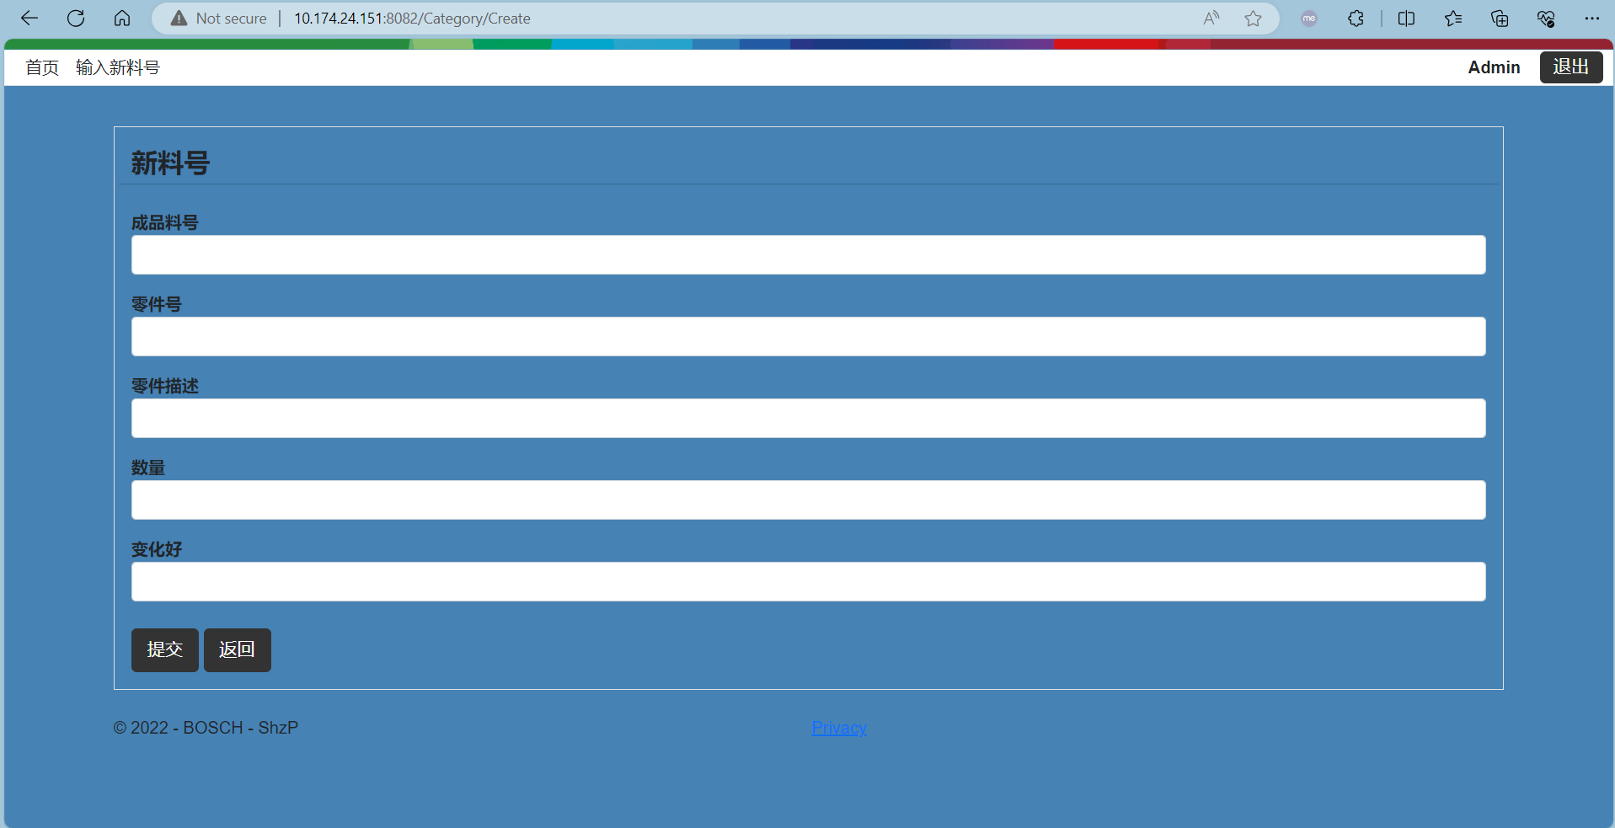
Demo
FB Material feeding poka-yoke (Backend Programming)

Slide 10
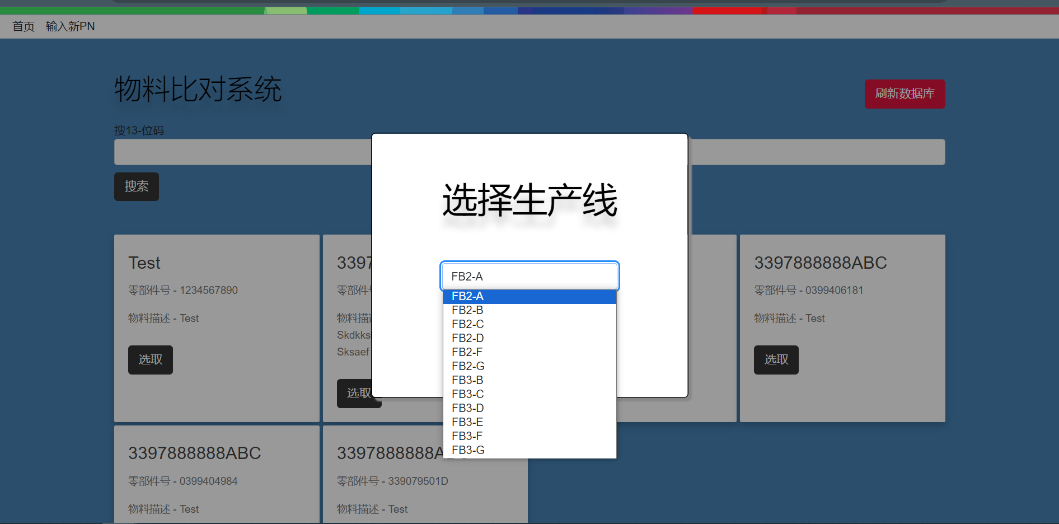
Demo
FB Material feeding poka-yoke (Backend Programming)

Slide 11
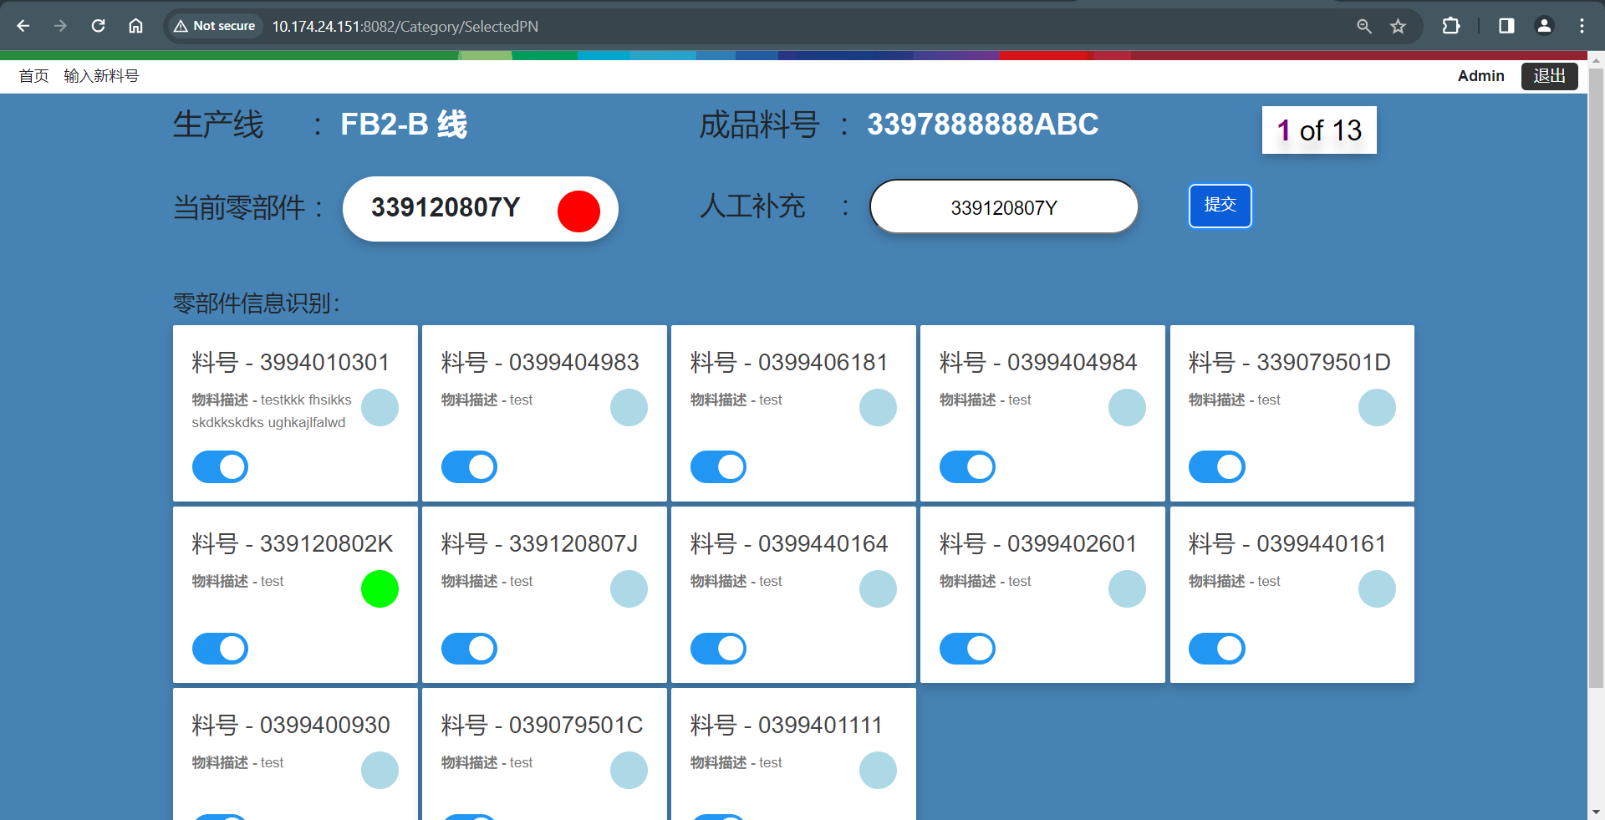
Demo
FB Material feeding poka-yoke (Backend Programming)

Slide 12

Demo
FB Material feeding poka-yoke (Backend Programming)

Slide 13
FB Material feeding poka-yoke (Backend Programming)

Slide 14
Thank you

